Slide 1
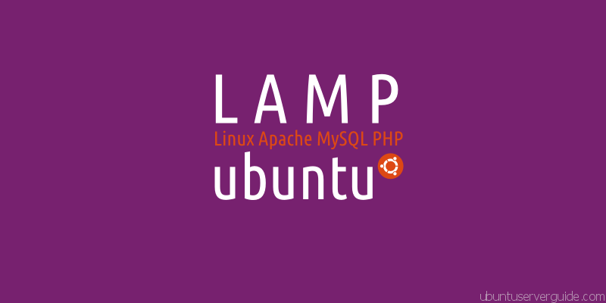
UEEN 3113 / 3413
Server Configuration and management

Slide 2
IT Governance
With the growth of direct connection between organisations and suppliers and customers, more and more focus on how IT can be used to add value to the business strategy.
IT resources should always be used as efficiently as possible.

Slide 3
IT Governance
IT Governance is part of a wider Corporate Governance activity with specific focus, covers the culture, organisation, policies and practices of IT.
IT Governance is the responsibility of executives and the board of directors, and consists of the leadership, organisational structures and processes that ensure that the organisation’s IT sustains and extends the organisation's strategies and objectives.

Slide 4
IT Governance
Why is it important?
IT has a pivotal role in improving corporate governance practices.
IT related risks has increased.
IT costs in all organisations.
To improve the management and control of IT activities.

Slide 5
IT Governance
Issues that drive the need for IT Governance:
Lack of accountability and clarity of ownership or responsibilities for IT services & projects due to inefficient communication between parties involved.
Gap between what IT departments think the business requires and what the business thinks the IT department is able to deliver.
Organisations need to have a better understanding of the value delivered by IT, both internally & from external suppliers.

Slide 6
IT Governance
Issues that drive the need for IT Governance:
Organisations are relying more and more on IT, management needs to be more aware of critical IT risks and whether they are being managed.
Management needs to understand whether the infrastructure underpinning today’s and tomorrow’s IT (technology, people, processes) is capable of supporting expected business needs.
IT is complex and fast changing.

Slide 7
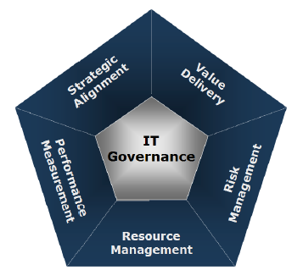
IT Governance
CobiT is an IT Control and Governance Framework.
There are 5 focus areas in IT governance:
Strategic alignment
Value delivery
Risk management
Resource management
Performance measurement

Slide 8
IT Governance
Strategic alignment
Linking business and IT plan
Defining, maintaining and validating the IT value proposition.
Aligning IT operations with the enterprise operations.
Provides collaborative solutions that
add value and competitive positioning to the enterprise’s products and services.
contains costs while improving administrative efficiency and managerial effectiveness.
Notes:
IT Governance A Framework for Performance and Compliance, Ron Saull

Slide 9
IT Governance
Value delivery
Executing the value proposition throughout the delivery cycle.
Ensuring that IT delivers the promised benefits against the strategy.
Concentrating on optimising expenses and proving IT’s value.
Controlling projects and operational processes with practices that increase the probability of success (quality, risk, time, budget, cost, etc.).
Notes:
IT Governance A Framework for Performance and Compliance, Ron Saull

Slide 10
IT Governance
Risk management
Requires awareness of senior officers, a clear understanding of the enterprise’s appetite for risk and transparency about the significant risks to the enterprise
Embeds risk management responsibilities in the enterprise operation
Addresses the safeguard of IT assets, disaster recovery and operation continuity
Notes:
IT Governance A Framework for Performance and Compliance, Ron Saull

Slide 11
IT Governance
Resource management
Optimal investment, use and allocation of IT resources and capabilities (people, applications, infrastructure, data).
Maximising the efficiency of these assets and optimising their costs.
Optimising knowledge and the IT infrastructure
Knowing where and how to outsource
Notes:
IT Governance A Framework for Performance and Compliance, Ron Saull

Slide 12
IT Governance
Performance measurement
Measuring relationships and assets necessary to compete: customer focus, process efficiency and the ability to learn and grow.
Tracking project delivery and monitoring IT services.
Notes:
IT Governance A Framework for Performance and Compliance, Ron Saull

Slide 13
IT Governance
A control framework for IT Governance is needed because it:
defines the reasons IT Governance is needed.
the stakeholders and
what it needs to accomplish

Slide 14
IT Governance
There are 5 principles in Cobit 5
Meeting Stakeholder Needs
Covering the Enterprise End-to-End
Applying a Single Integrated Framework
Enabling a Holistic Approach
Separating Governance From Management
Notes:
Introduction to COBIT 5, Robert E Stroud CGEIT SCRISC, ISACA Strategic Advisory Board

Slide 15
IT Governance
Meeting Stakeholders Needs
Enterprises exist to create value for stakeholders.
Each stakeholder has different concept of value – negotiate and decide amongst different stakeholders’ value interests.
Governance system should consider all stakeholders when making benefit, resource and risk assessment decisions.
Who receives the benefits? What resources are required? Who bears the risk?
Stakeholder needs will be transformed into enterprise’s actionable strategy.
Notes:
Introduction to COBIT 5, Robert E Stroud CGEIT SCRISC, ISACA Strategic Advisory Board

Slide 16
IT Governance
Covering the Enterprise End-to-end
Integrates enterprise IT governance into enterprise governance.
Aligns with the latest views on governance.
Covers all functions and processes within the enterprise.
Notes:
Introduction to COBIT 5, Robert E Stroud CGEIT SCRISC, ISACA Strategic Advisory Board

Slide 17
IT Governance
Applying a Single Integrated Framework
COBIT 5 aligns with the other latest relevant standards and frameworks
Enterprise: COSO (Committee of Sponsoring Organizations of the Treadway Commission) , COSO ERM (Enterprise risk management), ISO/IEC 9000, ISO/IEC 31000
IT-related: ISO/IEC 38500, ITIL (Information Technology Infrastructure Library), ISO/IEC 27000 series, TOGAF (The Open Group Architecture Framework), PMBOK/PRINCE2, CMMI, etc.
Notes:
Introduction to COBIT 5, Robert E Stroud CGEIT SCRISC, ISACA Strategic Advisory Board
PMBOK (Project Management Body of Knowledge),
PRINCE2 (PRojects IN Controlled Environments)
CMMI (Capability Maturity Model Integration)

Slide 18
IT Governance
Enabling a Holistic Approach
The enablers
Factors that influence whether something will work – governance and management over Enterprise IT
Driven by goals cascade (higher-level IT-related goals define what the different enablers should achieve)
Divided into 7 categories in COBIT framework.
Notes:
Introduction to COBIT 5, Robert E Stroud CGEIT SCRISC, ISACA Strategic Advisory Board

Slide 19
IT Governance
Enabling a Holistic Approach
The enablers categories
Principles, Policies and Framework are the vehicle to translate the desired behaviour into practical guidance for day-to-day management.
Processes describe an organised set of practices and activities. Process life cycle; Governance and Management Processes.
Organisational Structures describe RACI (responsible, accountable, consulted, informed) and roles.
Notes:
Introduction to COBIT 5, Robert E Stroud CGEIT SCRISC, ISACA Strategic Advisory Board

Slide 20
IT Governance
Enabling a Holistic Approach
The enablers categories
Culture, Ethics and Behaviour of individuals and enterprise are success factors in governance and management activities.
Information define its attributes: Physical (Carrier, Media); Empirical (User Interface); Syntactic (Language, Format); Semantic (Meaning); Type, Currency; Pragmatic (Use) Includes Retention, Status, Contingency, Novelty; and Social (Context)
Notes:
Introduction to COBIT 5, Robert E Stroud CGEIT SCRISC, ISACA Strategic Advisory Board

Slide 21
IT Governance
Enabling a Holistic Approach
The enablers categories
Services, Infrastructure and Applications. Includes: reuse, buy-vs-build, agility, simplicity and openness. Definition of Architecture Principles, Architecture Viewpoints, and Service Levels.
People, Skills and Competencies define Role Skill, Requirements, Skill Levels, Skill Categories and Skill Definitions.
Notes:
Introduction to COBIT 5, Robert E Stroud CGEIT SCRISC, ISACA Strategic Advisory Board

Slide 22
IT Governance
Separating Governance from Management
Make a clear distinction between governance and management.
Encompass different types of activities
Require different organisational structures
Serve different purposes
In most enterprises, governance is the responsibility of the board of directors under the leadership of the chairperson.
In most enterprises, management is the responsibility of the executive management under the leadership of CEO.
Notes:
Introduction to COBIT 5, Robert E Stroud CGEIT SCRISC, ISACA Strategic Advisory Board

Slide 23
IT Governance
Separating Governance from Management
Governance ensures that stakeholders needs, conditions and options are evaluated to determine balanced, agreed-on enterprise objectives to be achieved, setting direction through prioritisation and decision making and monitoring performance and compliance against agreed-on direction and objectives (EDM).
Notes:
Introduction to COBIT 5, Robert E Stroud CGEIT SCRISC, ISACA Strategic Advisory Board

Slide 24
IT Governance
Separating Governance from Management
Management plans, builds, runs and monitors (PBRM) activities in alignment with the direction set by the governance body to achieve the enterprise objectives.
Notes:
Introduction to COBIT 5, Robert E Stroud CGEIT SCRISC, ISACA Strategic Advisory Board

Slide 25
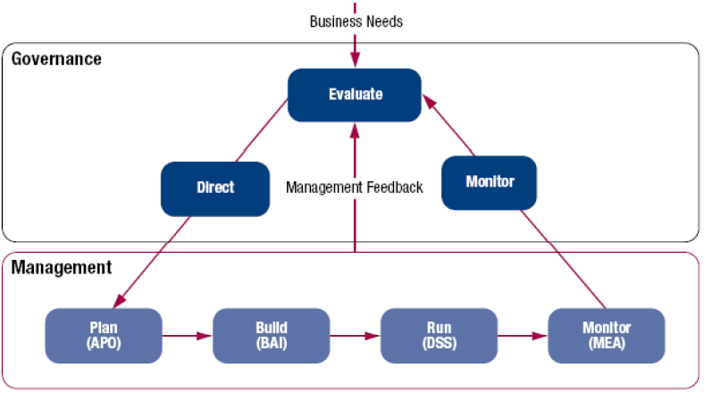
IT Governance
Separating Governance from Management
Notes:
Introduction to COBIT 5, Robert E Stroud CGEIT SCRISC, ISACA Strategic Advisory Board

Slide 26
IT Governance
Separating Governance from Management
Evaluate, Direct & Monitor (EDM)
EDM1 Set and Maintain the Governance Framework
EDM2 Ensure Value Optimisation
EDM3 Ensure Risk Optimisation
EDM4 Ensure Resource Optimisation
EDM5 Ensure Stakeholder Transparency
Notes:
Introduction to COBIT 5, Robert E Stroud CGEIT SCRISC, ISACA Strategic Advisory Board

Slide 27
IT Governance
Separating Governance from Management
Align, Plan & Organise (APO)
APO1 Define the Management Framework for IT
APO2 Manage Strategy
APO3 Manage Enterprise Architecture
APO4 Manage Innovation
APO5 Manage Portfolio
APO6 Manage Budget and Cost
APO7 Manage Human Resources
APO8 Manage Relationships
Notes:
Introduction to COBIT 5, Robert E Stroud CGEIT SCRISC, ISACA Strategic Advisory Board

Slide 28
IT Governance
Separating Governance from Management
Align, Plan & Organise (APO)
APO9 Manage Service Agreements
APO10 Manage Suppliers
APO11 Manage Quality
APO12 Manage Risk
APO13 Manage Security
Notes:
Introduction to COBIT 5, Robert E Stroud CGEIT SCRISC, ISACA Strategic Advisory Board

Slide 29
IT Governance
Separating Governance from Management
Build, Acquire & Implement (BAI)
BAI1 Manage Programmes and Projects
BAI2 Define Requirements
BAI3 Identify and Build Solutions
BAI4 Manage Availability and Capacity
BAI5 Manage Organisational Change Enablement Deliver, Service and Support
BAI6 Manage Changes
BAI7 Manage Change Acceptance and Transitioning
Notes:
Introduction to COBIT 5, Robert E Stroud CGEIT SCRISC, ISACA Strategic Advisory Board

Slide 30
IT Governance
Separating Governance from Management
Build, Acquire & Implement (BAI)
BAI8 Manage Knowledge
BAI9 Manage Assets
BAI10 Manage Configuration
Notes:
Introduction to COBIT 5, Robert E Stroud CGEIT SCRISC, ISACA Strategic Advisory Board

Slide 31
IT Governance
Separating Governance from Management
Deliver, Service & Support (DSS)
DSS1 Manage Operations
DSS2 Manage Service Requests and Incidents
DSS3 Manage Problems
DSS6 Manage Continuity
DSS5 Manage Security Services
DSS6 Manage Business Process Controls
Notes:
Introduction to COBIT 5, Robert E Stroud CGEIT SCRISC, ISACA Strategic Advisory Board

Slide 32
IT Governance
Separating Governance from Management
Monitor, evaluate & Assess (MEA)
MEA1 MEA Performance and Conformance
MEA2 MEA the System of Internal Control
MEA3 MEA Compliance with External Requirements
Notes:
Introduction to COBIT 5, Robert E Stroud CGEIT SCRISC, ISACA Strategic Advisory Board

Slide 33


